Slide 1
Secure Development Operations
(SecDevOps)
ANDRE HARDY

Slide 2
Application Development Life Cycle Model
An application development lifecycle model is a conceptual model that describes the stages involved in creating an application. Most projects use one of two major application development lifecycle models.
The waterfall model uses a sequential design process: as each stage is fully completed, the developers move on to
the next stage. This means that once a stage is finished, developers cannot go back to a previous stage without starting all over again.
The agile model was designed to overcome the disadvantages of the waterfall model. Instead of following a rigid sequential design process, the agile model takes an incremental approach. Developers might start with a simplistic project design and begin to work on small modules.

Slide 3
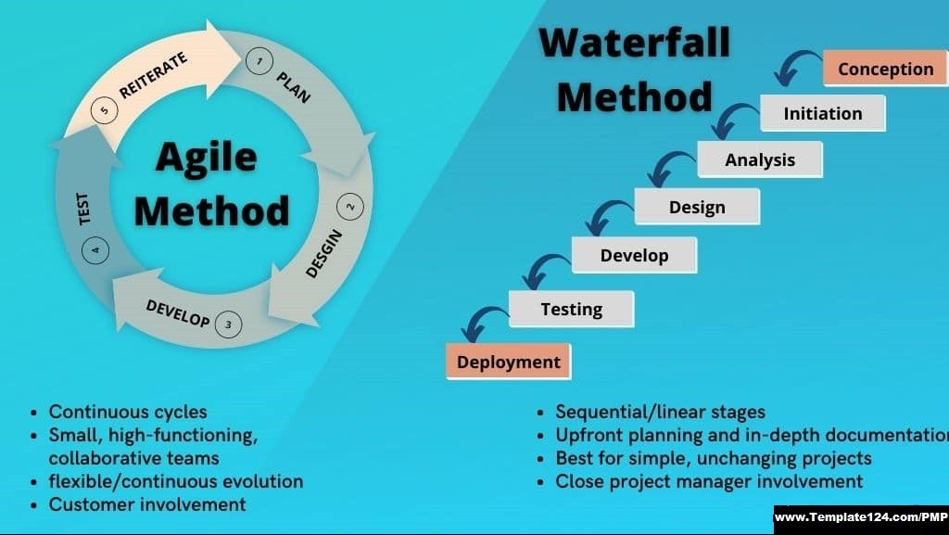

Slide 4
Application Development Life Cycle Model
Developing an application requires completing several stages. These stages include the following: • Development. At the development stage, the requirements for the application are established, and it is confirmed that the application meets the intended business needs before the actual coding begins.
Testing. The testing stage thoroughly tests the application for any errors that could result in a security vulnerability.
Staging. The staging stage tests to verify that the code functions as intended.
Production. In the production stage the application is released to be used in its actual setting.

Slide 5
Secure Application Development Life Cycle Model
One specific type of software methodology that follows the agile model and heavily incorporates secure coding practices and techniques to create secure software applications is called SecDevOps. Also known as DevSecOps, it is the process of integrating secure development best practices and methodologies into application software development and deployment processes using the agile model. It is a set of best practices designed to help organizations implant secure coding deep in the heart of their applications

Slide 6
SecDevOps
SecDevOps, short for Security Development and Operations, extends the principles of DevOps by integrating security practices directly into the software development and deployment pipelines.
SecDevOps incorporates security as a core principle alongside development and operations, emphasizing security automation, threat modeling, and security testing throughout the development process.
The primary goals of SecDevOps are to proactively identify and mitigate security vulnerabilities and threats during the software development lifecycle, resulting in more secure software.
In SecDevOps, security is integrated into the entire development process, from the design and planning phase to coding, testing, and deployment. Security is treated as an integral part of the software development lifecycle.

Slide 7
DevOps:
DevOps, short for Development and Operations, primarily focuses on streamlining and automating the software development and deployment processes to improve collaboration between development and IT operations teams.
DevOps emphasizes principles like continuous integration, continuous delivery (CI/CD), automation, and collaboration to accelerate software development and deployment.
The primary goals of DevOps are faster release cycles, increased software quality, and improved efficiency in software delivery.
While security is an essential consideration in DevOps, it is not the central focus. Security may be integrated into the process but is often seen as a separate concern.

Slide 8
DevOps & SecDevOps:
DevOps and SecDevOps are two related but distinct approaches to software development and operations, with a primary difference being the inclusion of security practices in SecDevOps. Here's a comparison and contrast between the two:In summary, DevOps and SecDevOps share many principles but differ primarily in the degree to which security practices are integrated into the development and operations processes. SecDevOps places security at the forefront and integrates it throughout the software development lifecycle, ensuring that security is not an afterthought but a core consideration.

Slide 9
References
Ciampa, M. (2020). CompTIA Security+ Guide to Network Security Fundamentals (7th ed.). Cengage Learning US.
https://mbsdirect.vitalsource.com/books/9780357424506
What is SDLC (Software Development Lifecycle)?
2023, Amazon Web Services, Inc. or its affiliates
What is SDLC? - Software Development Lifecycle Explained - AWS (amazon.com)
What is Application Development? 2023 ServiceNow
What is Application Development? – ServiceNow
What is DevSecOps? Microsoft 2023
What Is DevSecOps? Definition and Best Practices | Microsoft Security
“Agile Project Management Methodology vs. Waterfall Project Management Methodology: Understanding the Differences” by Muhammad Omair published Jul 8, 2023
Agile Project Management Methodology vs. Waterfall Project Management Methodology: Understanding the Differences (linkedin.com)

